Slide 1
Project-1
Sentiment Analysis using RNN with LSTMs
Arun Sharma(arunshar)
Aman Malkar(amansuni)

Slide 2
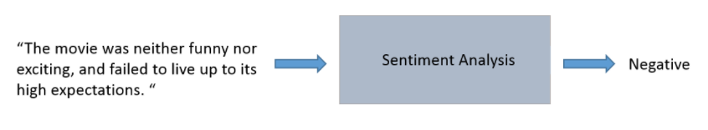
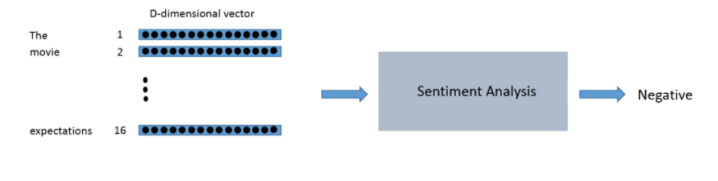
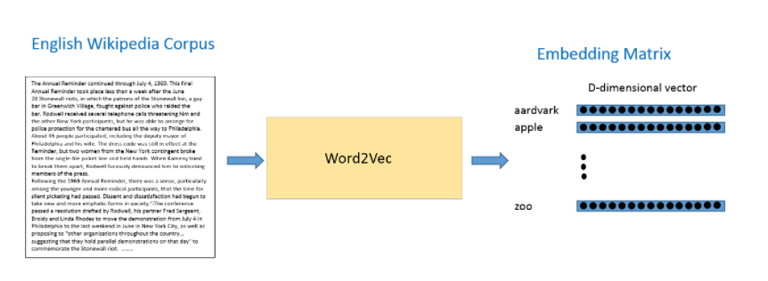
Abstract
Check the sentiment analysis on IMBb review dataset using Recurrent Neural Network with Long Short Term Memory
Further tuning hyper-parameters such as iterations, batch size and LSTM units and accordingly check the accuracy of the model.

Slide 3
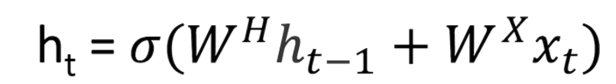
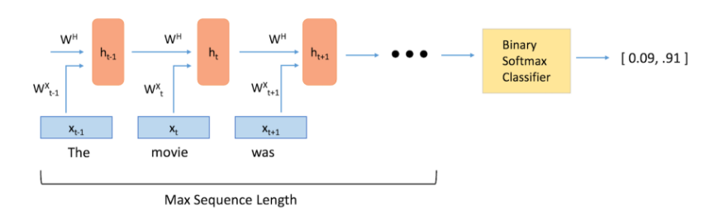
Model
For sentiment we used RNN since due to temporal nature of the data
At each step a new h_{t} is updated called hidden state.
W^{x} is weight matrix for multiply with input X_{t}
W^{H} is multiplied with hidden state at previous step.
Hidden state fed into softmax function for +/- sentiment

Slide 4
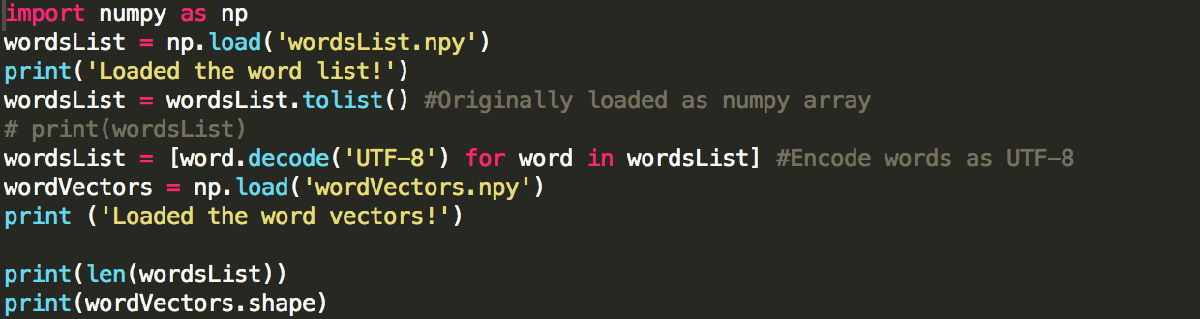
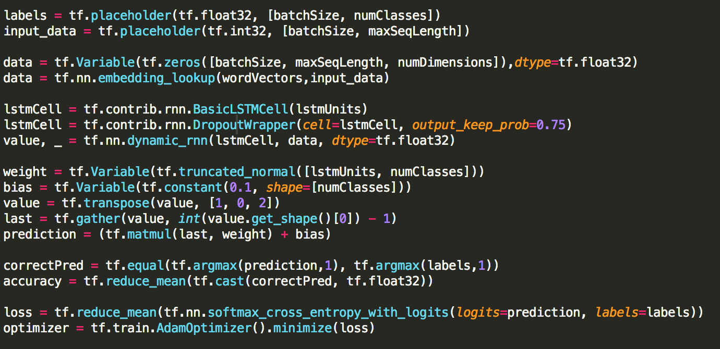
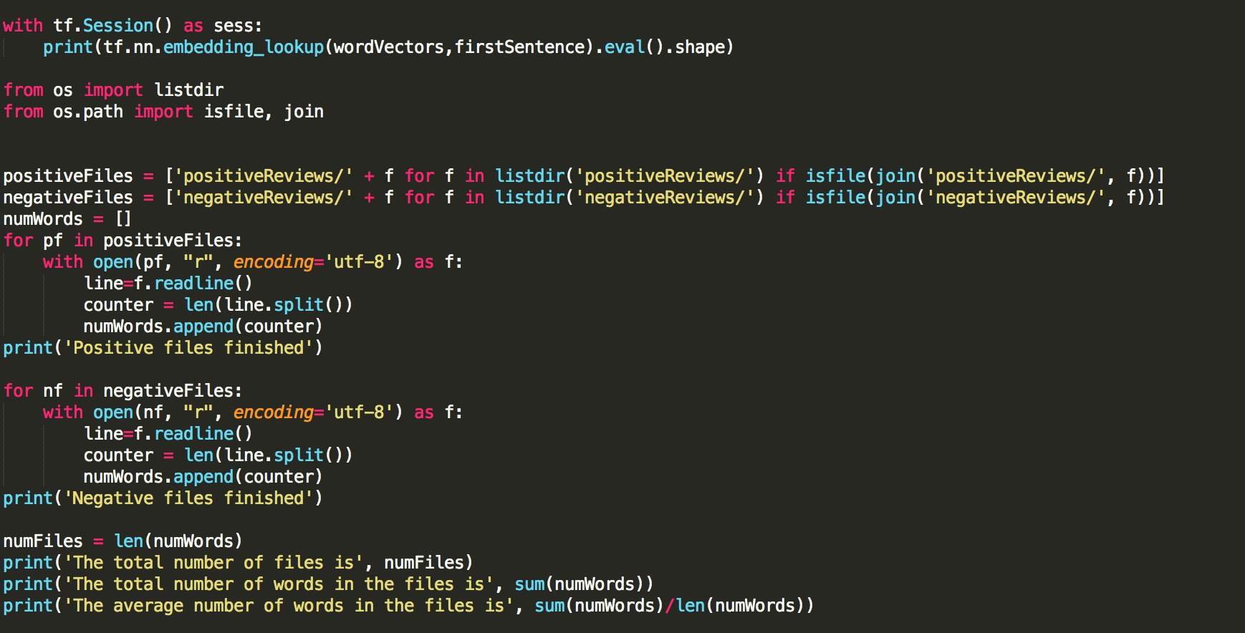
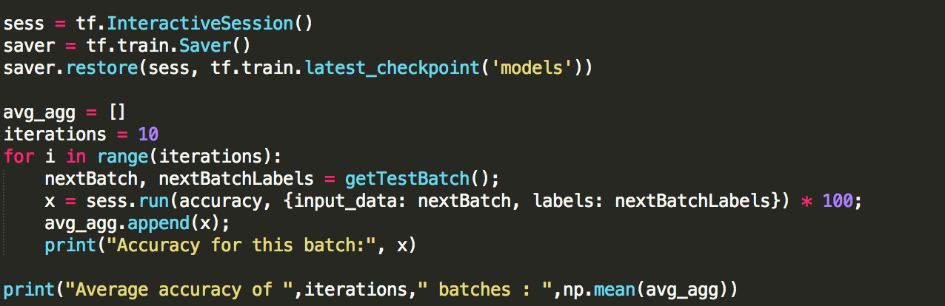
Code Snippets

Slide 5
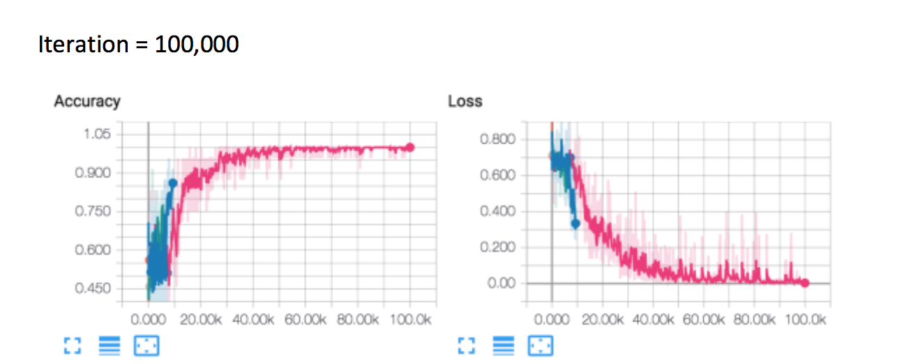
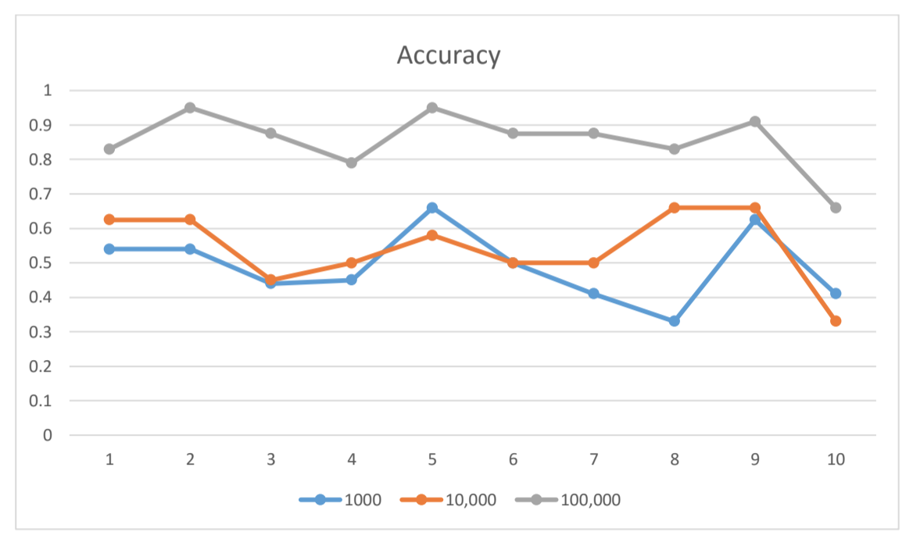
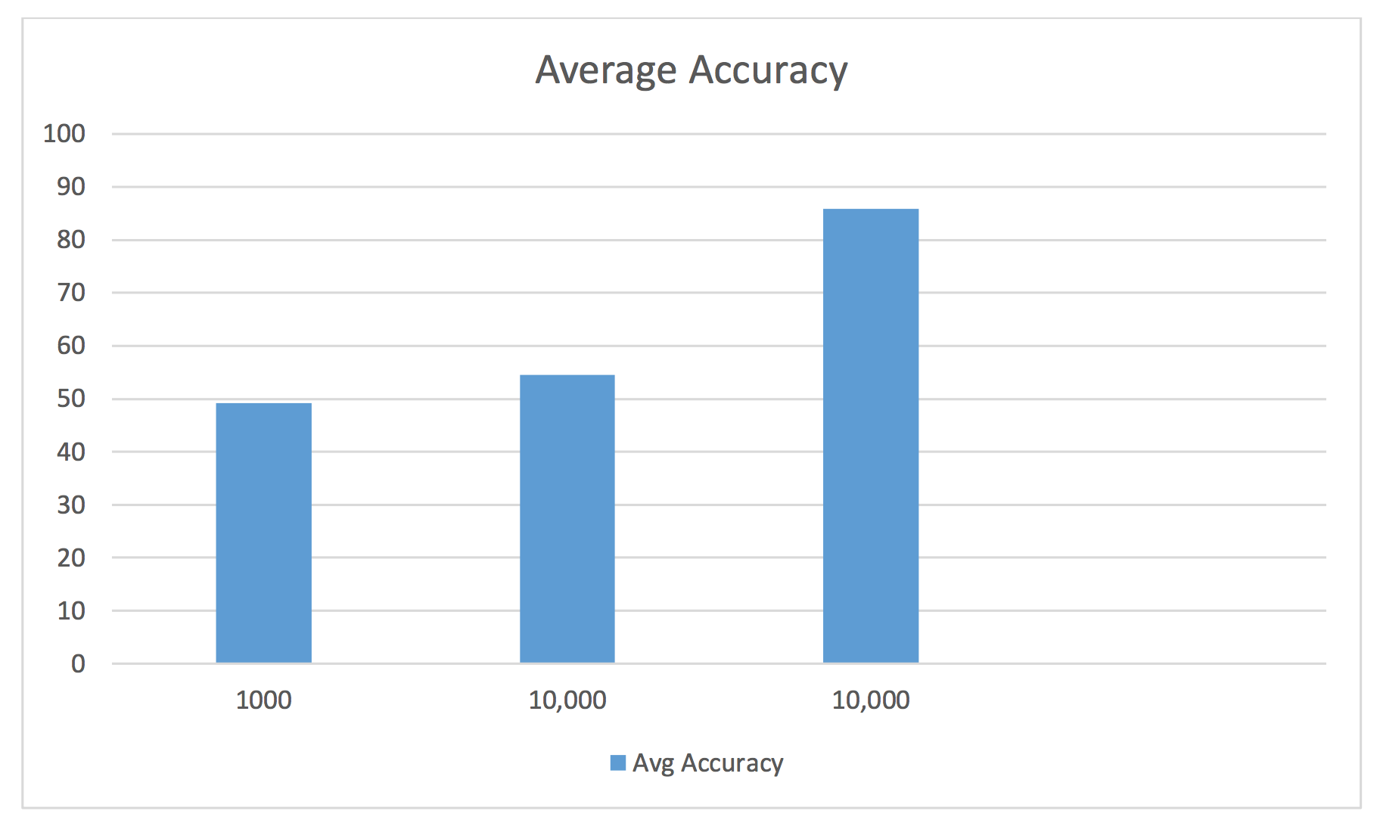
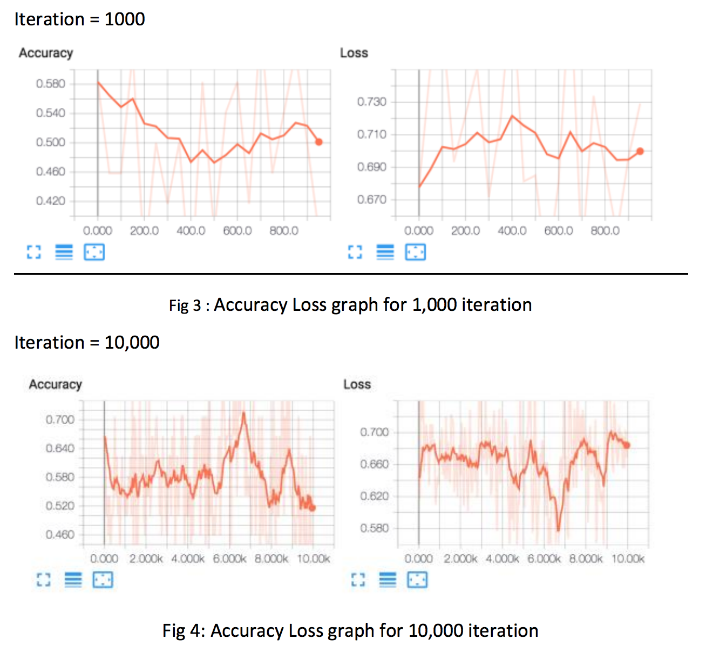
Conclusion and Results
Used Dropout 0.75 and AdamOptimizer for optimization
Got bet training accuracy as the iteration increases.
Similar trends in results were noticed of testing accuracy.

